Slide 1

Chapter 9
How to work with Arrays and Web storage
Notes:
Session: Ghi số thứ tự session trong môn học
Session Name: ghi tên của session sẽ dạy

Slide 2
Objectives
How to create and use an array
How to use methods of an Array object
Other skills for working with arrays
How to use web storage
The Task Manager application
Notes:
Mô tả nội dung mà học viên phải đạt được khi kết thúc môn học này

Slide 3
How to create and use an array
Notes:
Session: Ghi số thứ tự session trong môn học
Session Name: ghi tên của session sẽ dạy

Slide 4
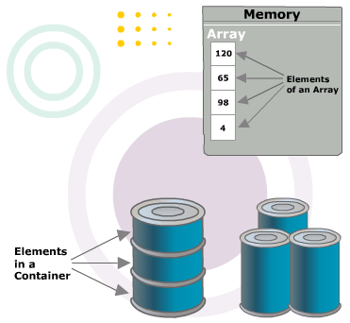
Introduction to Array
An array can store one or more elements
The length of an array is the number of elements in the array
Each of the element in the array is accessible through an integer value called a subscript
An array subscript begins from zero and is also called array index

Slide 5
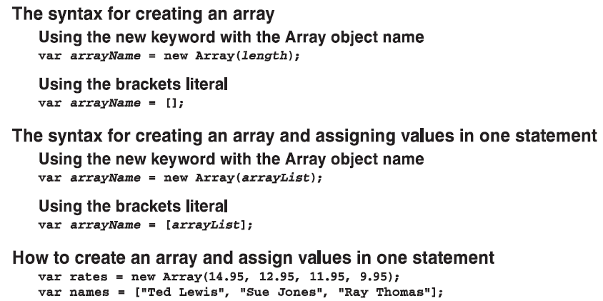
How to create an array

Slide 6
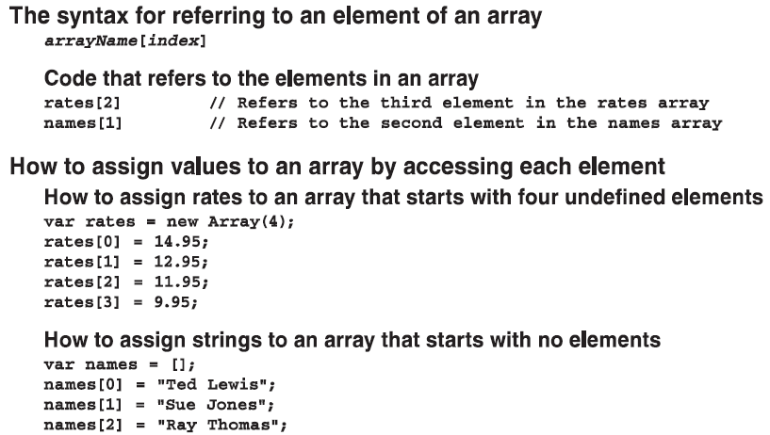
How to create an array (cont.)

Slide 7
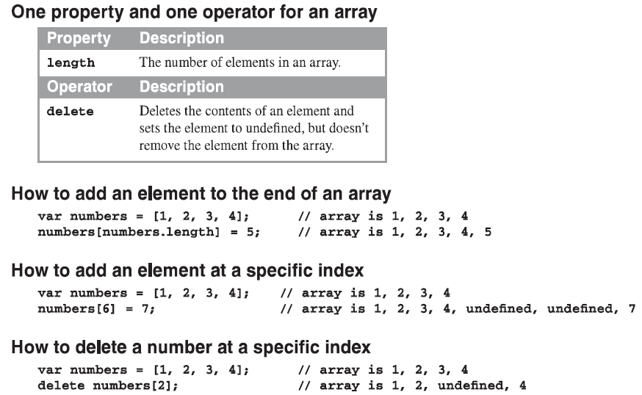
How to add and delete array elements

Slide 8
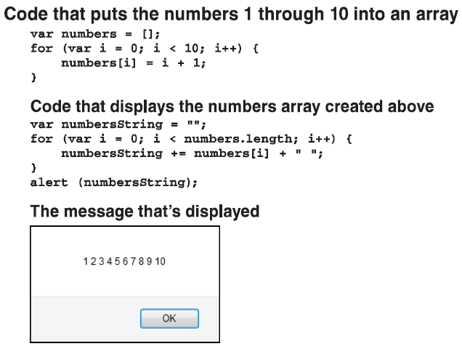
How to use for loops to work with arrays

Slide 9
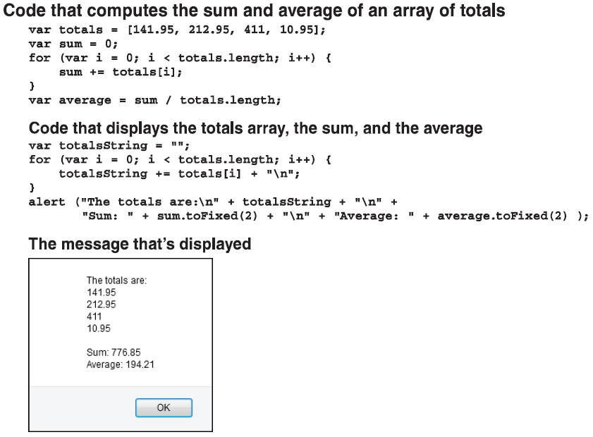
How to use for loops to work with arrays (cont.)

Slide 10
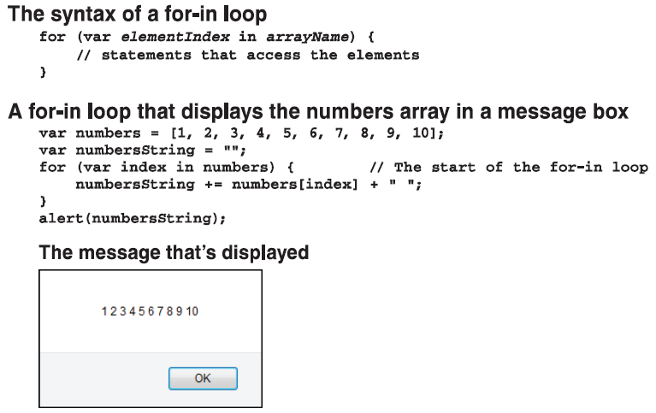
How to use for-in loops to work with arrays

Slide 11
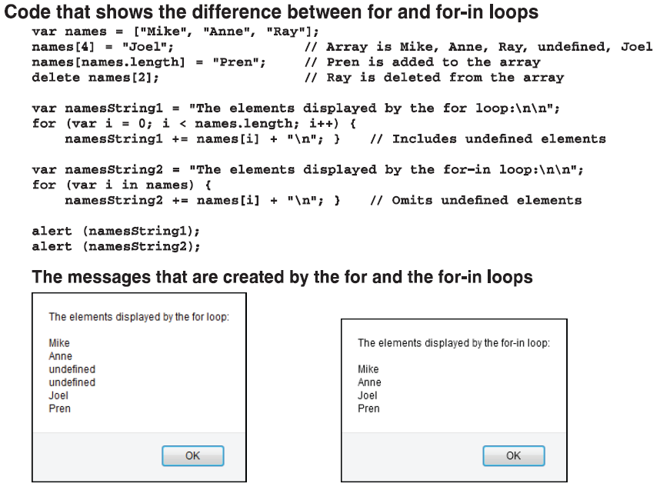
How to use for-in loops to work with arrays (cont.)

Slide 12
How to use the methods
of an Array object
Notes:
Session: Ghi số thứ tự session trong môn học
Session Name: ghi tên của session sẽ dạy

Slide 13
Methods of an Array object that access simple parameters
Method | Description
push(element_list) | Add one or more elements to the end of the array and returns the new length of the array.
pop() | Remove the last element in the array, decrements the length and returns the element that it removed.
unshift(element_list) | Add one or more elements to the beginning of the array and returns the new length of the array.
shift() | Remove the first element in the array, decrements the length and returns the element that it removed.
reverse() | Reverses the order of the elements in the array.
splice(start, number) | Remove the number of elements from index is start and returns the elements that were removed.
splice(start, number, element_list) | Remove the number of elements from index is start, replace them by element in element_list and returns the elements that were removed.

Slide 14
Methods of an Array object that access simple parameters(cont.)
Method | Description
slice(start,number) | Return a new array with number of element in number parameter and from index in start parameter.
concat(array_list) | Return a new array that consists of the original array concatenated with the array in the array list.
join([separator]) | Convert all the elements of array to string and concatenates them separated with separator parameter
toString() | Same join() method with separator is comma.
toLocaleString() | Same toString() method but using a locale specific separator
isArray(object) | Checks whether the object passed to it is an array.
indexOf(value, start) | Return the first index at which value is found. Return -1 if the value is not found.
lastIndexOf(value, start) | Return the last index at which value is found. Return -1 if the value is not found.

Slide 15
Methods of an Array object that access functions as parameters
Method | Description
sort([comparision function]) | Accepts an optional function to change the default sort order, if no parameter ascending sort will be apply.
forEach(function, this) | Accepts a function that is executed once for each element. Returns a value of undefined.
every(function, this) | Accepts a function that tests each element in the array to meet a specific condition. Returns true if all element pass the test, false otherwise.
some(function, this) | Accepts a function that tests each element in the array to meet a specific condition. Returns true if at least element passes the test, false otherwise.
map(function, this) | Accepts a function that is execute one for each element, and returns a new array containing the result of each function call.
filter(function, this) | Accepts a function that is execute one for each element, and returns a new array containing the element that meet the specific condition of the function.

Slide 16
Methods of an Array object that access functions as parameters (cont.)
Method | Description
reduce(function, init) | Accept a function that returns all the elements reduced to one value, processed in ascending order.
reduceRight(function, init) | Accept a function that returns all the elements reduced to one value, processed in descending order.

Slide 17
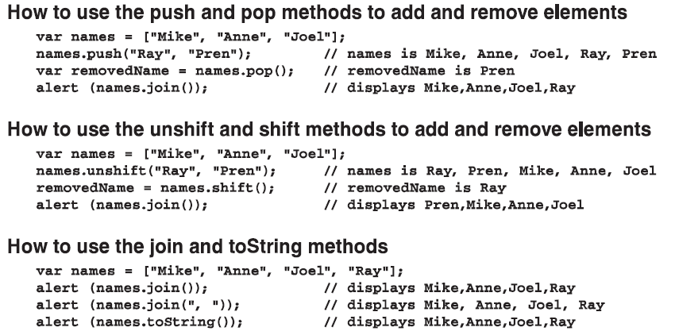
Examples of the Array methods

Slide 18
Examples of the Array methods (cont.)
How to use the sort() method
For Alphanumeric sorting
var names=[“Grace”, “Charles”, “Ada”, “Alan”, “Linus”];
names.sort(); //names is Ada,Alan,Charles,Grace,Linus
For numeric sorting in ascending sequence
var comparision = function(x, y){
return x-y;
};
Var numbers = [520, 33, 9, 199];
numbers.sort(comparision); //numbers is 9,33,199,520

Slide 19
Examples of the Array methods (cont.)
How to use the map() method
var numbers=[1, 4, 9, 16];
var squared = numbers.map(function( value ){
return value * value;
});
var root = numbers.map( Math.sqrt ); //Root is 1,2,3,4
How to use filter() method
var numbers = [1,2,3,4,5,6,7,8,9,10,11,12,13,14,15,16,17,18,19,20];
var checkPrime = function( value ){
var isPrime = true;
for( var i=2; i<value; i++){
if(value % i === 0){
isPrime = false; break;
}
}
return isPrime;
}
Var prime = numbers.filter(checkPrime);
//Prime is 1,2,3,7,11,13,17,19

Slide 20
Other skills for working with arrays
Notes:
Session: Ghi số thứ tự session trong môn học
Session Name: ghi tên của session sẽ dạy

Slide 21
How to use a String method to create an array
A String method that creates an array
Example use split() method to create an array
var fullName= “Grace M Hopper”;
var nameParts = fullName.split(“ ”); //Create an array
alert(nameParts.lenght); //display 3
alert(nameParts) //display Grace,M,Hopper
var lastName = nameParts[nameParts.length -1];
alert(lastName);
Method | Description
split(separator,limit) | Split a string into an array.

Slide 22
How to create and use an associative array
When you create an associative array, you use string as the indexes instead of numbers.
How to create an associative array with 4 elements
var item = [];
item[“itemCode”] = 123;
item[“itemName”] = “HTML5”;
item[“itemCost”] = 54.5;
item[“itemQuantity”] = 5;
alert(item.length); //display 0
alert(Object.keys(item).length); //display 4

Slide 23
How to create and use an associative array (cont.)
How to add an element to the associative array
item[“lineCost”] =(item[“itemCost”] *
item[“itemQuantity”]).toFixed(2);
How to retrieve and display the elements in the associative array
alert(“Item elements: \n” +
”\nCode = ” + item[“itemCode”] +
“\nName = ”+ item[“itemName”] +
“\nCost = ” + item[“itemCost”] +
“\nQuantity = ” + item[“itemQuantity”] +
“\nLine Cost =” + item[“lineCose”]);

Slide 24
How to create and use an array of arrays
How to create and use an array of arrays
Code that create an array of arrays
var testScores = [];
var testScores[0] = [80, 82, 90, 87, 85];
var testScores[1] = [79, 80, 74];
var testScores[2] = [93, 95, 89, 100];
var testScores[3] = [60, 72, 75, 71];
Code that refer elements in the array of arrays
alert(testScores[0][1]); //display 82
alert(testScores[2][3]); //display 100

Slide 25
How to create and use an array of arrays (cont.)
How to create and use an array of associative arrays
Code that create an array of arrays
var invoice = [];
Code that add an associative array to invoice array
invoice[0] = [];
invoice[0][“itemCode”] = 123;
invoice[0][“itemName”] = “HTML5”;
invoice[0][“itemCost”] = 54.5;
invoice[0][“itemQuantity”] = 5;
Code that refer elements in the array of associative arrays
alert(invoice[0][“itemCode”]);//display 123
alert(invoice[0][“itemName”]);//display HTML5

Slide 26
How to use web storage
Notes:
Session: Ghi số thứ tự session trong môn học
Session Name: ghi tên của session sẽ dạy

Slide 27
Web Storage introduction
Cookies is limit by 4,000 bytes. So if you want to store more, you must use web storage.
Web storage let web page use JavaScript to store data in key/value pairs.
There are two storage types are: local storage and session storage.
Local storage is retained indefinitely, session storage is lost when session end.

Slide 28
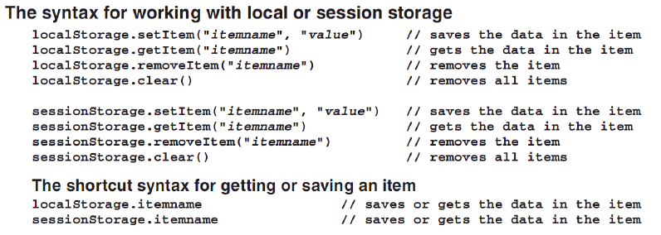
The syntax to work with storage

Slide 29
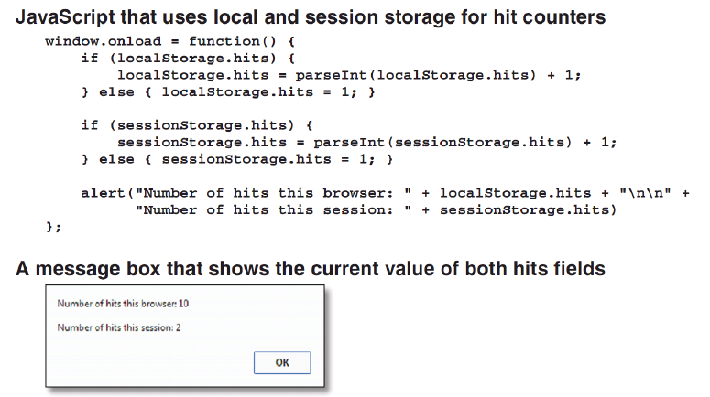
Use JavaScript to work with storage

Slide 30
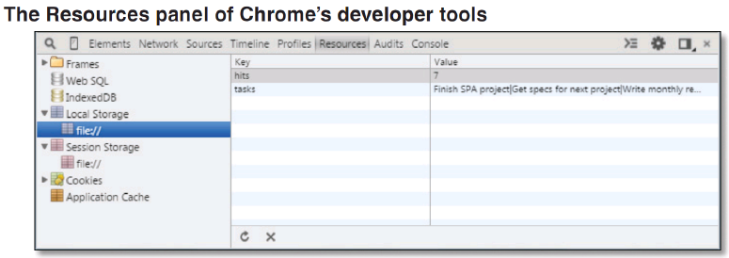
Use Chrome to view and edit item in web storage
Press F12 button -> Select Resource tab.

Slide 31
The Task Manager application
Notes:
Session: Ghi số thứ tự session trong môn học
Session Name: ghi tên của session sẽ dạy

Slide 32
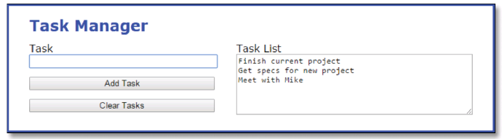
The Task Manager application
The User Interface

Slide 33
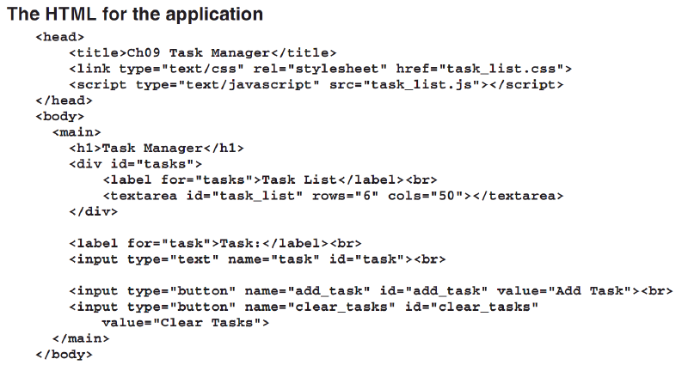
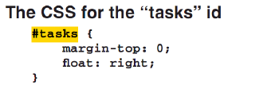
The Task Manager application

Slide 34
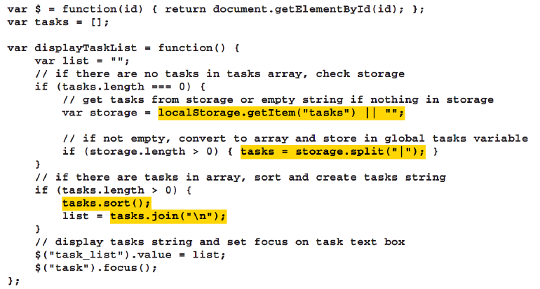
The Task Manager application
The JavaScript Code

Slide 35
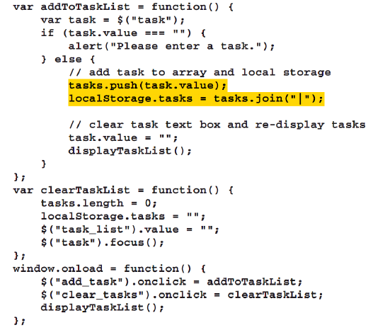
The Task Manager application

Slide 36
Summary
An array can store one or more elements. The length of an array is the number of elements in the array.
Each of the element in the array is accessible through an integer value called a subscript. Subscript start from 0.
You can use for loops or for-in loops to works with array elements.
You can use the split() method of a String object to create an array from substrings within a string.
An associative array uses strings for the indexes instead of numbers.
In an array of arrays, each element in one array contains another array.
Web storage can used to use to replace cookies to over limit 4,000 byte in each items.
Notes:
Tóm tắt lại nội dung đã học

Slide 37
The End.

